Slide 1
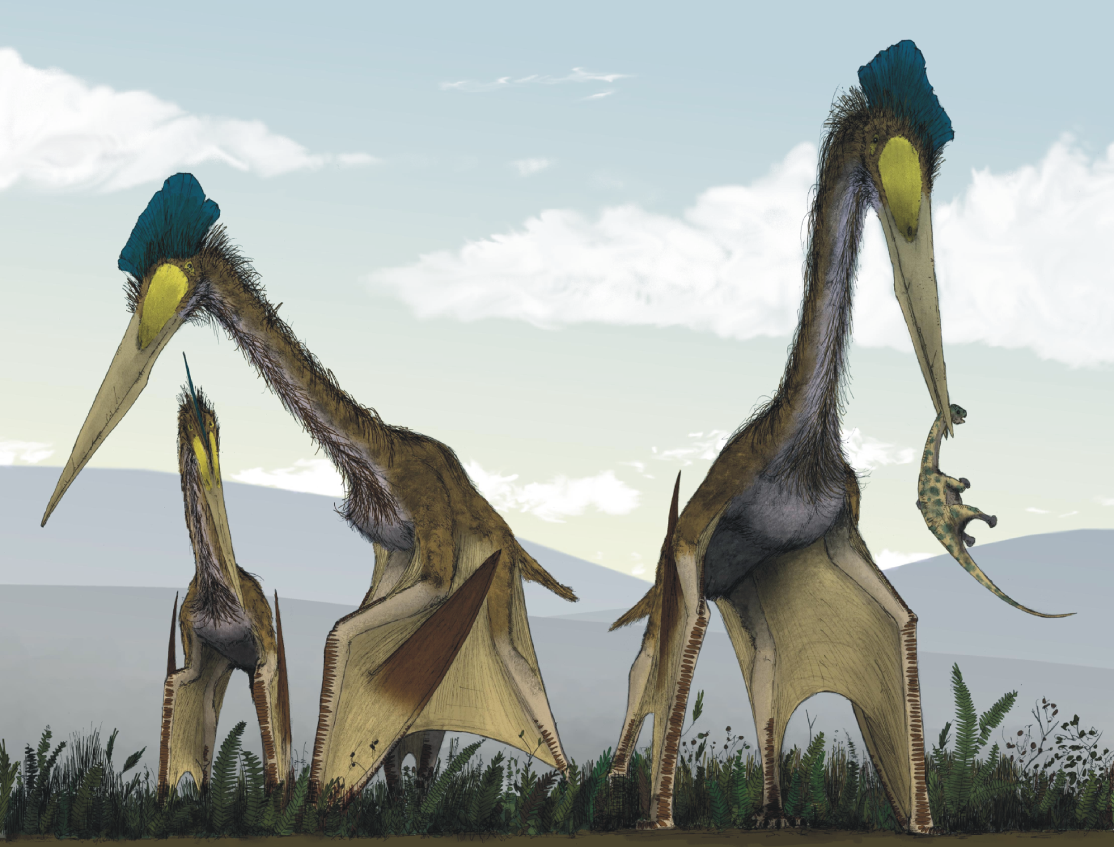
XFLR5 Methods and Their Application in “Constraints on the Wing Morphology of Pterosaurs”
By: Colin Parker

Slide 2
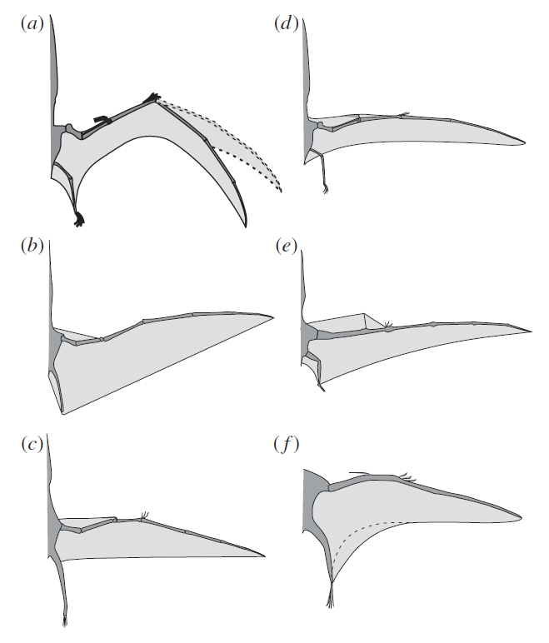
Constraints on the wing morphology of pterosaurs
Wing shape is a mystery
Few soft tissue fossils
No studies looking at the aerodynamic components
Want to combine biomechanical and aerodynamic constraints to predict shape
Notes:
Motivation for study is to recreate wing formation
Fossil records only show hard tissue
Combine biological constraints with aerodynamic
Shown are some
Straite
Swept forward/back

Slide 3
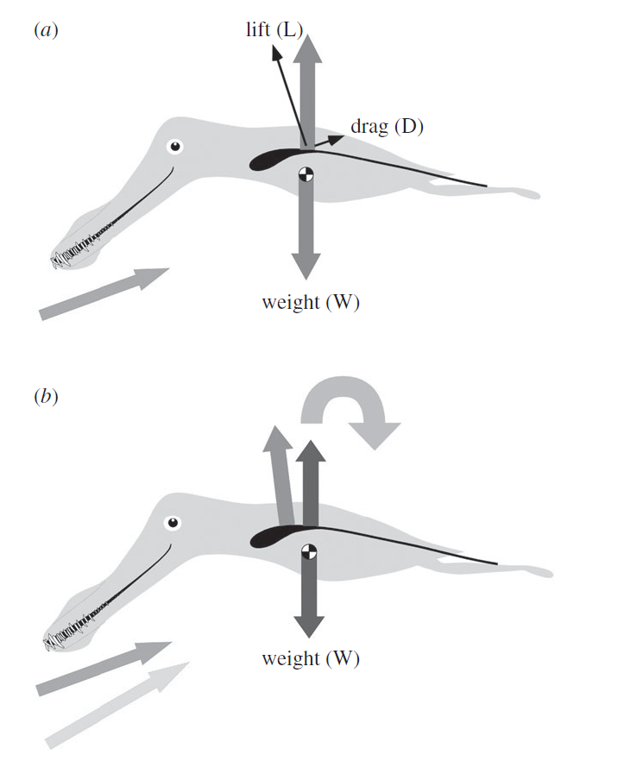
Longitudinal Stability Analysis
Notes:
On aspect is longitudinal stability
Increase lift when ahead of center of mass pitch up
Pitch up increase lift more thus unstable
This paper tried to match Ac

Slide 4
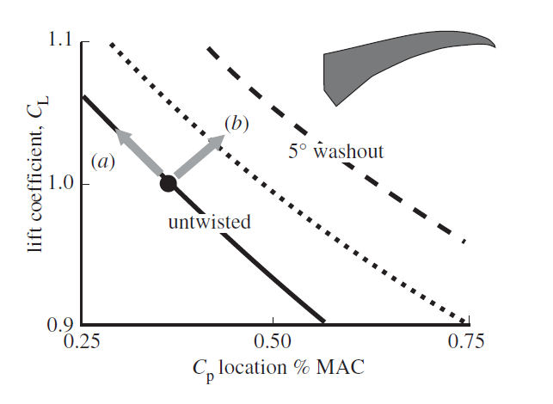
Effects of Washout

Slide 5
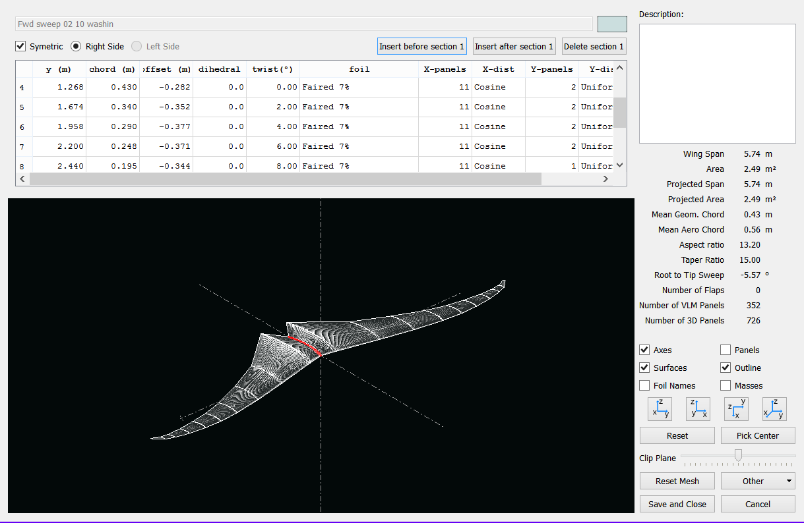
XFLR5

Slide 6
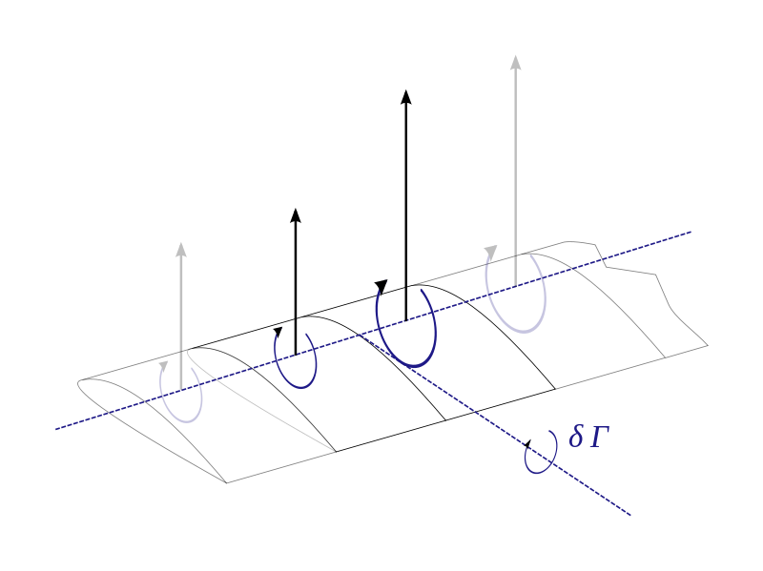
LLT Lifting Line Theory
Kutta_Joukowski
Biot-Savart
Helmholtz Theorem
The strength of a vortex filament is constant along its length
A vortex filament cannot end in a fluid: must extend to infinity or form a closed path
Effective angle of attack
Repeat

Slide 7
LLT
Limitations
Does not account for sweep
Does not account for dihedral
Inviscid
Must have high Aspect Ratio

Slide 8
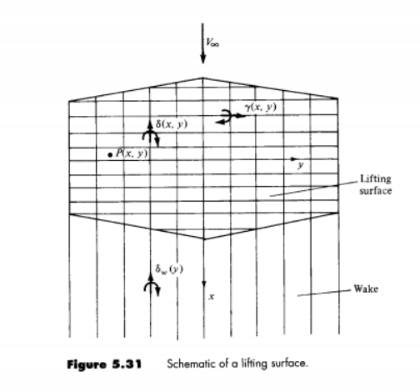
Lifting Surface Theory
Series of lifting lines
Circulation varies in both
Span wise lifting line
Chord wise vortices
Chord wise vortices extend into wake.
Biot-Savart
Flow tangency condition

Slide 9
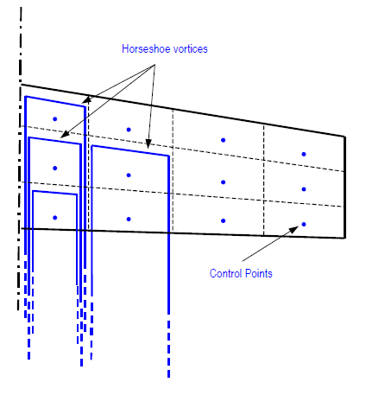
VLM Vortex Lattice Method
Assign circulation at control points
Biot-Savart Law
Flow tangency

Slide 10
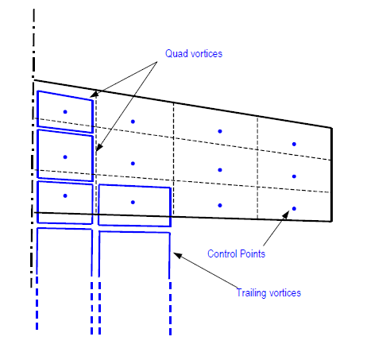
VLM2
Uses quad or ring vortices on surface
Uses horseshoe vortices on trailing edge to model wake
Biot-Savart has V~1/r^3 so difference in trailing vortices is typically minor

Slide 11
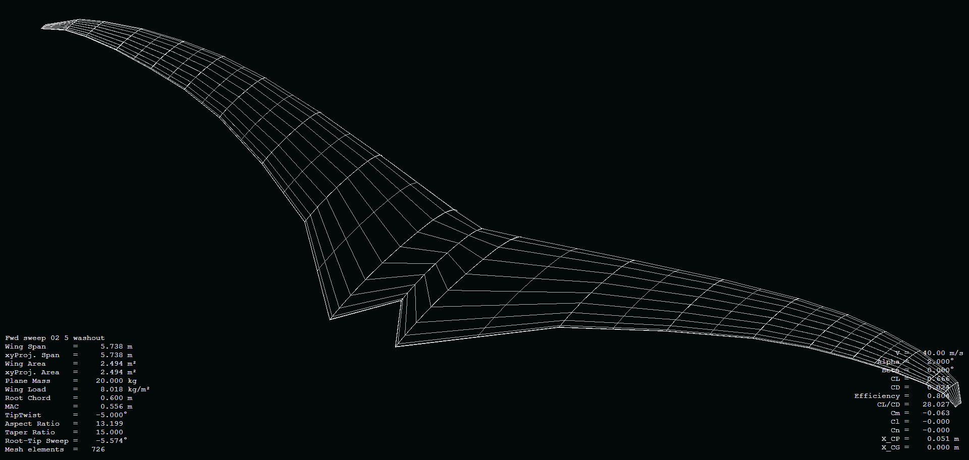
3D Panel Method
Sources and Doublets distributed evenly across each panel
Potential calculated at control points
Boundary layer analysis
Recalculation of potential at control points
Full field calculated with potential field

Slide 12
3D Panel Method
Advantages
Boundary Conditions
Takes into account wing thickness
Maps Cp over top and bottom
Von Nuemann
Tangential flow condition
Dirichlet
Potential inside body = Freestreem potential

Slide 13
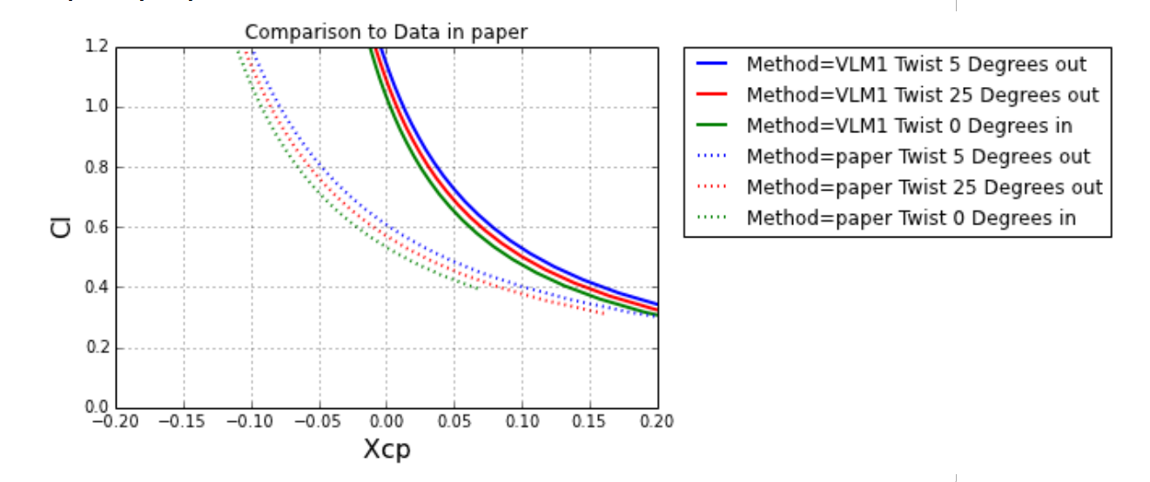
Created Wings Compared to Results in the Paper

Slide 14
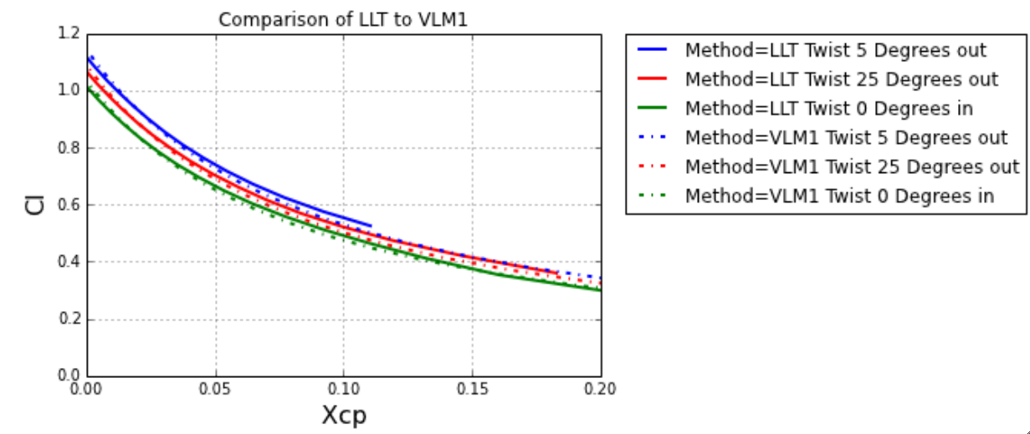
LLT Compared to VLM1 Results

Slide 15
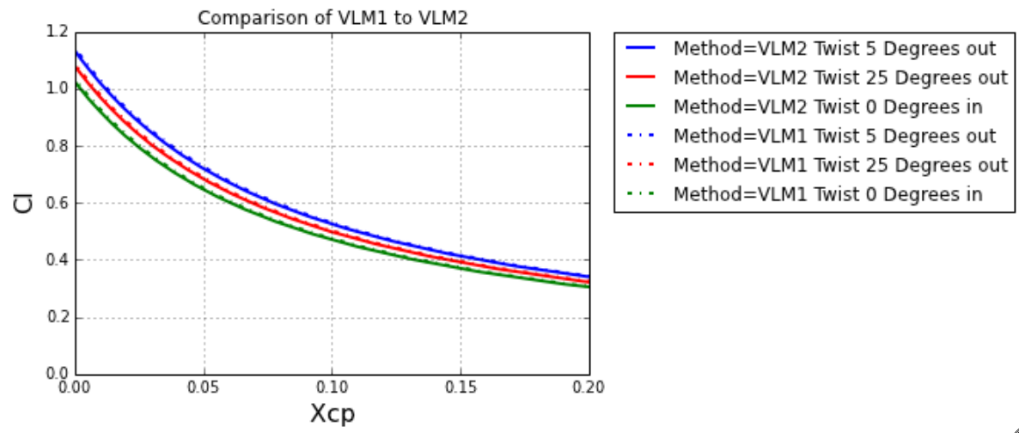
VLM2 Compared to VLM1

Slide 16
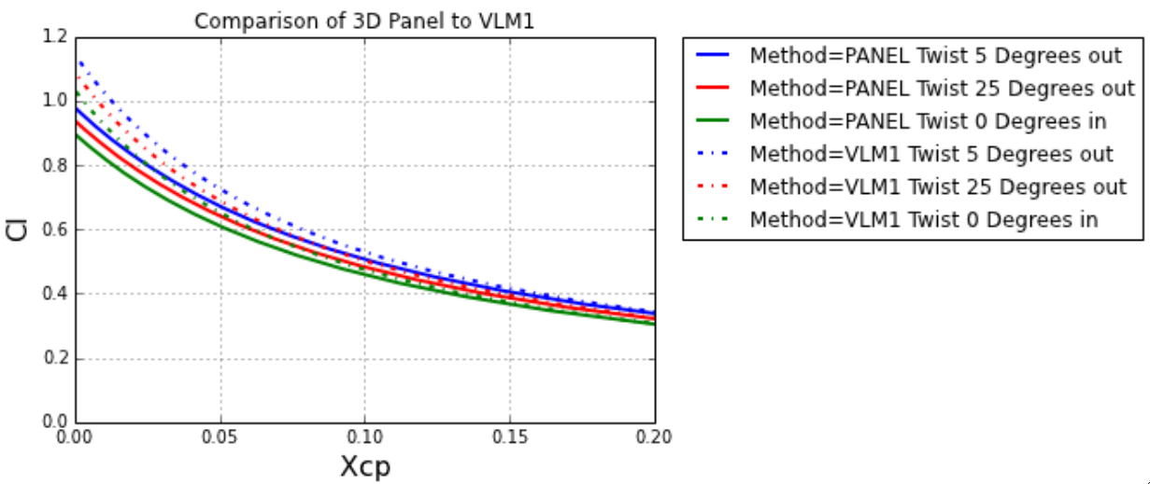
3D Panel Compared to VLM1

Slide 17
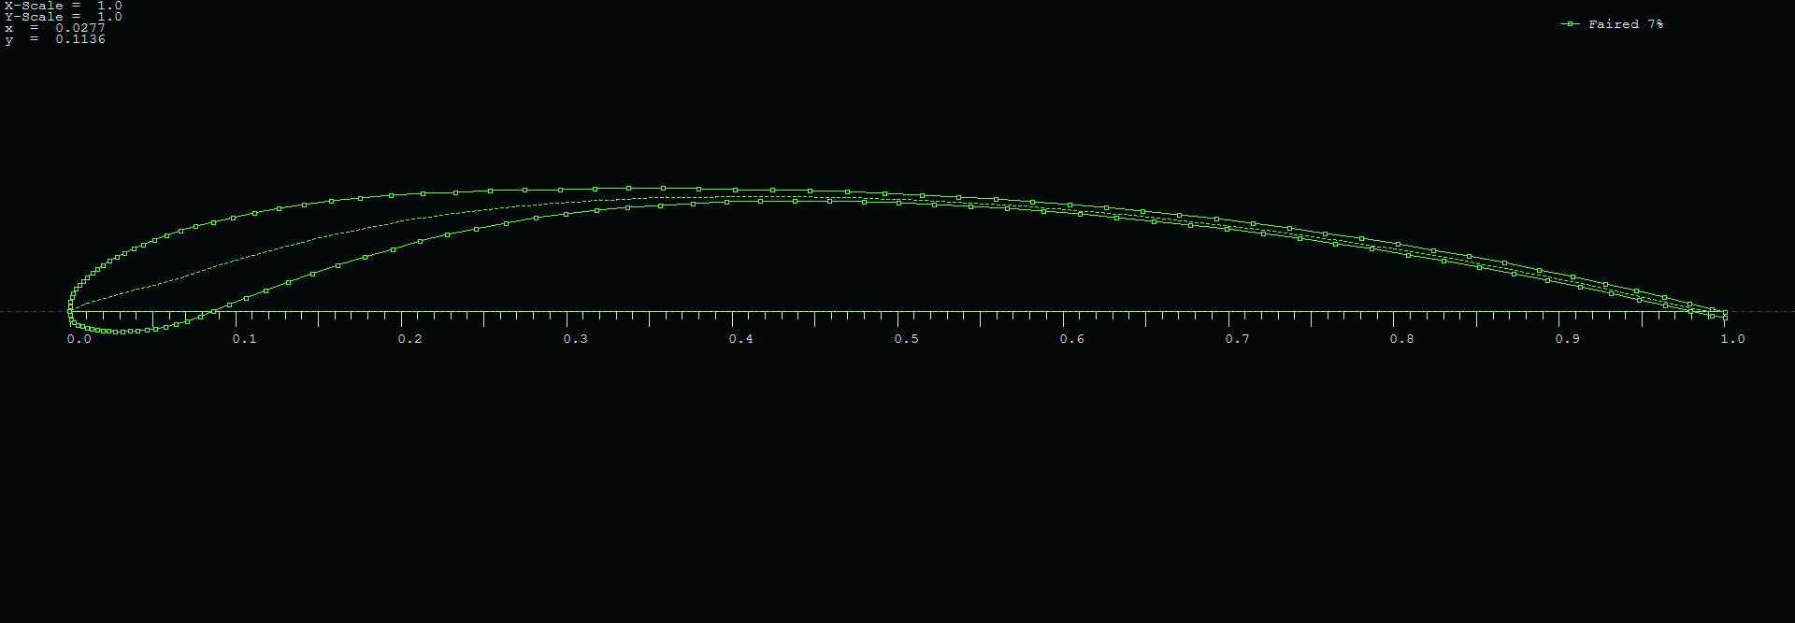
Airfoil Shape

Slide 18
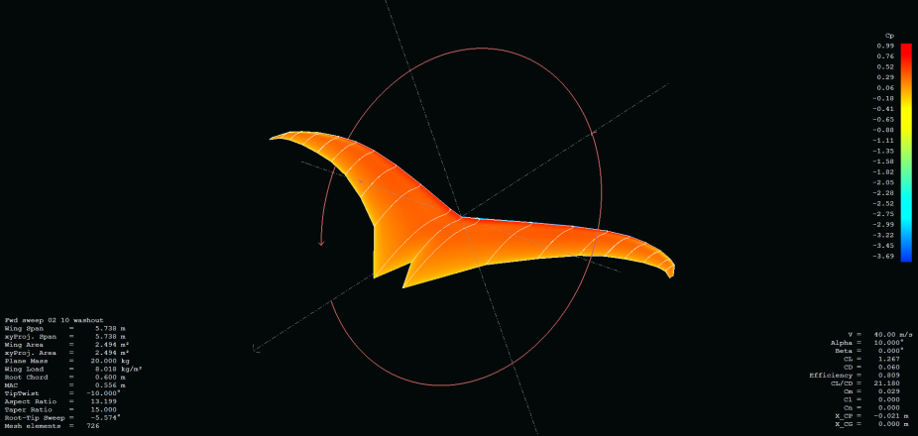
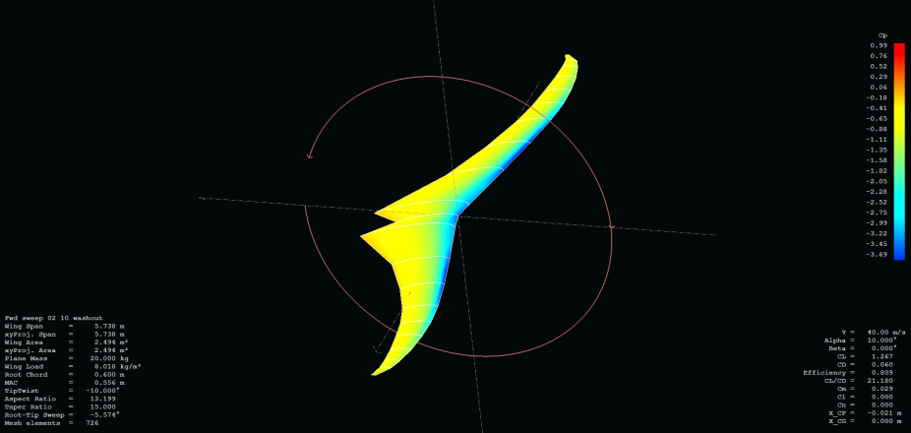
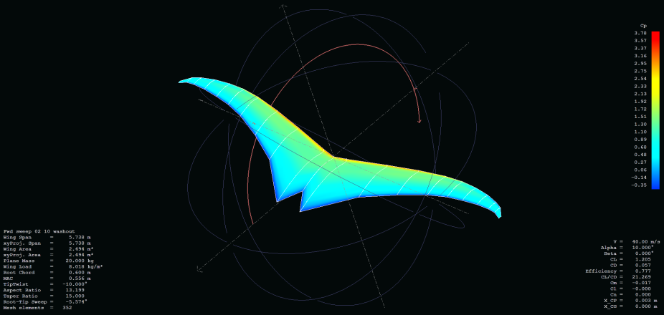
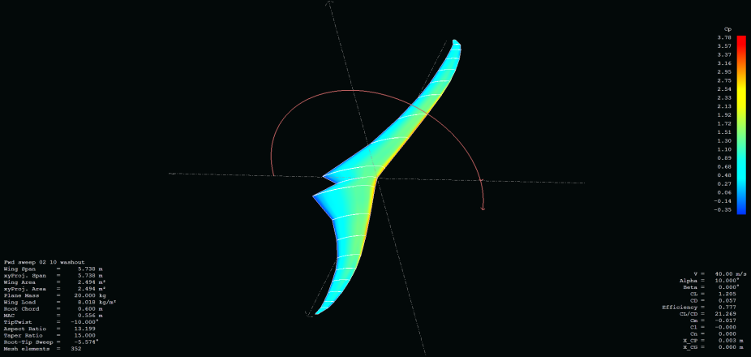
Cp Distribution
3D Panel
VLM1

Slide 19
Conclusions
VLM and 3D panel method yield different results
Due to the variable thickness, 3D Panel method may yield more accurate results
Potential flow models may be limited in flapping flight applications
Trends shown are repeatable

Slide 20
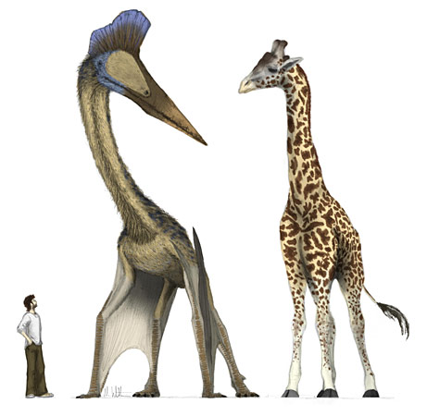
Question?

